Slide 1
SWE4005- Storage Technology and Management
Business continuity

Slide 2
Why Business Continuity (BC)?
Information is an organization’s most important asset
Continuous access to information ensures smooth functioning of business operations
Cost of unavailability of information to an organization is greater than ever
Threats to information availability
Natural disasters
flood, fire, earthquake
Unplanned occurrences
cybercrime, human error, network and computer failure
Planned occurrences
upgrades, backup, restore
result in the inaccessibility of information
Notes:
Module 9: Introduction to Business Continuity

Slide 3
What is Business Continuity?
Business Continuity
It is a process that prepares for, responds to, and recovers from a system outage that can adversely affects business operations.
An integrated and enterprise-wide process that includes set of activities to ensure “information availability”
BC involves proactive measures (data protection, and security) and reactive countermeasures (disaster recovery and restart) to be invoked in the event of a failure.
In a virtualized environment, BC solutions need to protect both physical and virtualized resources.
The goal of a BC solution is to ensure the “information availability” required to conduct vital business operations.
Notes:
Module 9: Introduction to Business Continuity

Slide 4
Information Availability
Information Availability
It is the ability of an IT infrastructure to function according to business expectations, during its specified time of operation.
Information availability can be defined with the help of:
Accessibility
Information should be accessible to the right user when required
Reliability
Information should be reliable and correct in all aspects
Timeliness
Defines the time window during which information must be accessible
Notes:
Module 9: Introduction to Business Continuity

Slide 5
Causes of Information Unavailability
Disaster (<1% of Occurrences)
Natural or man made disaster
Flood
Fire
Earthquake
Contamination
Unplanned Outages (20%)
Failure
Database corruption
Component (physical and/or virtual) failure
Human error
Planned Outages (80%)-expected and scheduled but still cause data to be unavailable
Competing workloads
Backup, reporting
Data warehouse extracts
Application and data restore
Various planned and unplanned incidents result in data unavailability
Notes:
Module 9: Introduction to Business Continuity

Slide 6

Impact of Downtime
Lost Productivity
Know the downtime costs (per hour, day, two days, and so on.)
Lost Revenue
Number of employees impacted x hours out x hourly rate
Direct loss
Compensatory payments
Lost future revenue
Billing losses
Investment losses
Damaged Reputation
Financial Performance
Customers
Suppliers
Financial markets
Banks
Business partners
Revenue recognition
Cash flow
Lost discounts (A/P)
Payment guarantees
Credit rating
Stock price
Other Expenses
Temporary employees, equipment rental, overtime costs, extra shipping costs, travel expenses, and so on.
Notes:
Module 9: Introduction to Business Continuity

Slide 7
Impact of Downtime (contd.)
Average cost of downtime per hour
Average productivity loss per hour
Average revenue loss per hour
Average productivity loss per hour + average revenue loss per hour
(total salaries and benefits of all employees per week) / (average number of working hours per week)
(total revenue of an organization per week) / (average number of hours per week that an organization is open for business)

Slide 8
Measuring Information Availability
Information availability relies on the availability of both physical and virtual components of a data center.
Failure of these components might disrupt information availability.
A failure is the termination of a component’s ability to perform a required function.
The component’s ability can be restored by performing an external corrective actions, such as a manual reboot, a repair, or replacement of the failed component(s).
Proactive risk analysis, performed as part of the BC planning process, considers the component failure rate and average repair time, which are measured by MTBF (Mean Time Between Failure) and MTTR (Mean Time To Repair)

Slide 9
Measuring Information Availability (contd.)
MTBF = Mean Time Between Failure
MTTR = Mean Time To Repair
Time to repair or ‘downtime’
Response Time
Recovery Time
Detection
Repair
Restoration
Incident
Incident
Diagnosis
Recovery
Time
Detection elapsed time
Repair time
Time between failures or ‘uptime’
MTBF: Average time available for a system or component to perform its normal operations between failures MTBF = Total uptime/Number of failures
MTTR: Average time required to repair a failed component MTTR = Total downtime/Number of failures
Notes:
Module 9: Introduction to Business Continuity

Slide 10
Measuring Information Availability (contd.)
MTBF = Mean Time Between Failure
MTTR = Mean Time To Repair
IA can be expressed in terms of system uptime and downtime and measured as the amount or percentage of system uptime:
IA = MTBF/(MTBF + MTTR) or IA = uptime/(uptime + downtime)
System uptime is the period of time during which the system is in an accessible state
System downtime is the period of time during which the system is not accessible state
Notes:
Module 9: Introduction to Business Continuity

Slide 11
Availability Measurement – Levels of ‘9s’ Availability
Uptime per year is based on the exact timeliness requirements of the service.
This calculation leads to the number of “9s” representation for availability metrics.
Table lists the approximate amount of downtime allowed for a service to achieve certain levels of 9s availability.
For example, a service that is said to be “five 9s available” is available for 99.999 percent of the scheduled time in a year (24 ×365).
Uptime (%) | Downtime (%) | Downtime per Year | Downtime per Week
98 | 2 | 7.3 days | 3hrs, 22 minutes
99 | 1 | 3.65 days | 1 hr, 41 minutes
99.8 | 0.2 | 17 hrs, 31 minutes | 20 minutes, 10 secs
99.9 | 0.1 | 8 hrs, 45 minutes | 10 minutes, 5 secs
99.99 | 0.01 | 52.5 minutes | 1 minute
99.999 | 0.001 | 5.25 minutes | 6 secs
99.9999 | 0.0001 | 31.5 secs | 0.6 secs
Notes:
Module 9: Introduction to Business Continuity

Slide 12
BC Planning and Technology Solutions
During this lesson the following topics are covered:
BC terminologies
BC planning
Business impact analysis
Single points of failure
Multipathing software

Slide 13
BC Terminologies – 1
Disaster recovery
Disaster restart
Coordinated process of restoring systems, data, and infrastructure required to support business operations after a disaster occurs
Process of restarting business operations with mirrored consistent copies of data and applications
Restoring previous copy of data and applying logs to that copy to bring it to a known point of consistency
Generally implies use of replication technologies
Generally implies use of backup technology
Notes:
Module 9: Introduction to Business Continuity

Slide 14
BC Terminologies – 2
Based on the RPO, organizations plan for the frequency with which a backup or replica must be made
Recovery-Point Objective (RPO)
Point-in-time to which systems and data must be recovered after an outage
Amount of data loss that a business can endure
RPO of 24 hours: Backups are created at an offsite tape library every midnight. Recovery strategy: to restore data from the set of last backup tapes.
RPO of 6 hours: Backups must be made at least once in 6 hours
Weeks
Tape Backup
RPO of 1 hour: Backup to the remote site every hour. Recovery strategy is to recover the database to the point of the last log shipment.
Days
Periodic Replication
Hours
Asynchronous Replication
Minutes
Seconds
Synchronous Replication
RPO in the order of minutes: Mirroring data asynchronously to a remote site.
Recovery-point objective
RPO of zero: Mirroring data synchronously to a remote site.
Notes:
Module 9: Introduction to Business Continuity

Slide 15
BC Terminologies – 2
Based on the RTO, organizations plan for recovery strategies to ensure data availability
Recovery-Time Objective (RTO)
Time within which systems and applications must be recovered after an outage
Amount of downtime that a business can endure and survive
RTO of 72 hours: Restore from tapes available at a cold site
RTO of 12 hours: Restore from tapes available at a hot site.
RTO of few hours: Use disk-based backup technology, which gives faster restore than a tape backup.
Weeks
Tape Restore
RTO of a few seconds: Cluster production servers with bidirectional mirroring, enabling the applications to run at both sites simultaneously.
Days
Disk Restore
Hours
Manual Migration
Minutes
Global Cluster
Cold site: a site when operations can be moved in the event of disaster, with minimum IT infrastructure in place, but not activated
Hot site: a site when operations can be moved in the event of disaster. All equipment is available and running at all times
Seconds
Recovery-time objective
Notes:
Module 9: Introduction to Business Continuity

Slide 16
BC Planning Lifecycle
Determine BC requirements.
Estimate the scope and budget to achieve requirements.
Select a BC team that includes subject matter experts from all areas of the business, whether internal or external.
Create BC policies.
Train the employees who are responsible for backup and replication
Train employees on emergency response procedures
Perform damage-assessment processes and review recovery plans
Test the BC plan regularly to evaluate its performance and identify its limitations
Establishing Objectives
Analyzing
Designing and Developing
Implementing
Training, Testing, Assessing, and Maintaining
Collect information on data profiles, business processes, infrastructure support
Conduct a business impact analysis.
Identify critical business processes and assign recovery priorities.
Perform risk analysis for critical functions and create mitigation strategies.
Perform cost benefit analysis.
Evaluate options.
Implement risk management and mitigation procedures
Prepare the DR sites that can be utilized if a disaster affects the primary data center
Implement redundancy for every resource in a data center to avoid single points of failure
Define the team structure and assign individual roles and responsibilities
Design data protection strategies and develop infrastructure
Develop contingency solution
Notes:
Module 9: Introduction to Business Continuity

Slide 17
Failure Analysis
Involves analyzing both physical and virtual infrastructure components
To identify systems that are susceptible to a single point of failure and implementing fault-tolerance mechanisms.
Single Point of Failure
Resolving Single Points of Failure
Multipathing Software

Slide 18
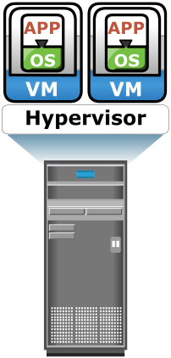
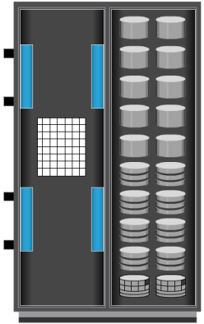

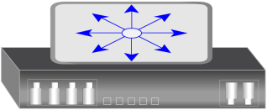
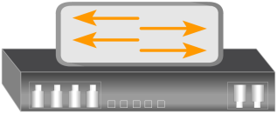
Failure Analysis: (1) Single Points of Failure
Single Points of Failure
It refers to the failure of a component of a system that can terminate the availability of the entire system or IT service.
Array port
Client
IP Switch
FC Switch
Server
Storage Array
A VM, a hypervisor, or an HBA/NIC on the server, the physical server itself, the IP network, the FC switch, the storage array port, or even the storage array could be a potential single point of failure
E.g.: For example, failure of a hypervisor can affect all the running VMs and virtual network, which are hosted on it
Notes:
Module 9: Introduction to Business Continuity

Slide 19
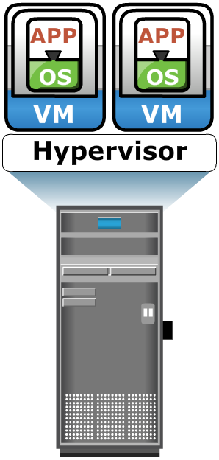
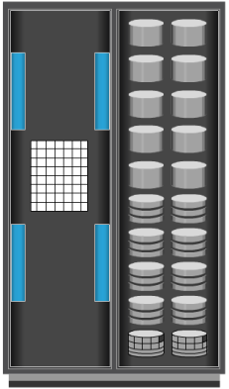

Failure Analysis: (2) Resolving Single Points of Failure / Fault tolerant
Redundant Arrays
Client
Redundant Paths
Redundant Ports
NIC
HBA
NIC
HBA
IP
Redundant Network
Redundant FC Switches
NIC
HBA
Production Storage Array
Remote Storage Array
NIC Teaming
NIC
HBA
To mitigate a single point of failure, systems are designed with redundancy, such that the system will fail only if all the components in the redundancy group fail.
This ensures that the failure of a single component does not affect data availability.
Careful analysis is performed to eliminate every single point of failure
Clustered Servers
Notes:
Module 9: Introduction to Business Continuity

Slide 20
Failure Analysis: (2) Resolving Single Points of Failure / Fault tolerant
Based on the figure, implementation to resolve single points of failure includes:
Configuration of multiple HBAs to mitigate single HBA failure.
Configuration of multiple fabrics to account for a switch failure.
Configuration of multiple storage array ports to enhance the storage array’s availability.
RAID configuration to ensure continuous operation in the event of disk failure.
Implementing a storage array at a remote site to mitigate local site failure.
Implementing server (host) clustering, a fault-tolerance mechanism whereby two or more servers in a cluster access the same set of volumes.
Clustered servers exchange heartbeats to inform each other about their health.
If one of the servers fails, the other server takes up the complete workload.

Slide 21
Failure Analysis: (3) Multipathing Software
Configuration of multiple paths increases the data availability through path failover
Multipathing software provides the functionality to recognize and utilize alternative I/O paths to data
E.g.: Microsoft Multipath I/O (MPIO) is a Microsoft-provided framework that allows storage providers to develop multipath solutions that contain the hardware-specific information needed to optimize connectivity with their storage arrays
Provides load balancing by distributing I/Os to all available, active paths:
Intelligently manages the paths to a device by sending I/O down the optimal path:
Improves I/O performance and data path utilization
Based on the load balancing and failover policy setting for the device
Notes:
Module 9: Introduction to Business Continuity

Slide 22
Business Impact Analysis
Identifies which business units and processes are essential to the survival of the business
BIA includes the following set of tasks:
Determine the business areas
Identify key business processes critical to its operation
Determine attributes of the business process: applications, databases, h/w, s/w
Estimates the cost of failure for each business process
Calculates the maximum tolerable outage and defines RTO for each business process
Businesses can prioritize and implement countermeasures to mitigate the likelihood of such disruptions
Notes:
Module 9: Introduction to Business Continuity

Slide 23
BC Technology Solutions
After analyzing the business impact of an outage, designing the appropriate solutions to recover from a failure is the next important activity
Solutions that enable BC are:
Fault tolerant configuration
Done by implementing redundancies
Resolving single points of failure
Multipathing software
Backup and replication
Backup and recovery
Local replication
Remote replication
Notes:
Module 9: Introduction to Business Continuity

Slide 24
Backup and Replication
Note: Backup and Replication will be discussed in forthcoming modules.
Backup and Recovery
Backup to tape has been a predominant method to ensure BC
Frequency of backup is determined based on RPO, RTO, and the frequency of data changes
Local Replication
Data can be replicated to a separate location within the same storage array.
Remote Replication
Data in a storage array can be replicated to another storage array located at a remote site.
The replica is used independently for BC operations.
Replicas can also be used for restoring operations if data corruption occurs.
If the storage array is lost due to a disaster, BC operations start from the remote storage array.

Slide 25


EMC PowerPath
Host Application
Host-based multipathing software
Provides path failover and load-balancing functionality
Automatic detection and recovery from host-to-array path failures
PowerPath/VE software allows optimizing virtual environments with PowerPath multipathing features
PowerPath
HOST
HBA Driver
HBA Driver
HBA Driver
HBA Driver
HBA
HBA
HBA
HBA
Storage Network
STORAGE
LUNs
25
Notes:
Module 9: Introduction to Business Continuity

Slide 26
A network router has a failure rate of 0.02 percent per 1 ,000 hours. What is the MTBF of that component?
Solution: MTBF of network router = 1/Failure rate

Slide 27
The IT department of a bank promises customer access to the currency conversion rate table between 9:00 am and 4:00 pm from Monday to Friday. It updates the table every day at 8:00 am with a feed from the mainframe system. The update process takes 35 minutes to complete. On Thursday, due to a database corruption, the rate table could not be updated. At 9:05 am, it was established that the table had errors. A rerun of the update was done and the table was recreated at 9:45 am Verification was run for 15 minutes and the rate table became available to the bank branches. What was the availability of the rate table for the week in which this incident took place, assuming there were no other issues?

Slide 28
Availability = total uptime/total scheduled time Total scheduled time = 7 hrs * 5 = 35 hrs Total up time = 34 hrs (as on Thursday rate table was made available at 10:00 am instead of 9:00 am) Therefore, availability of the rate table for the week = 34/35

Slide 29
